Slide 1
Deep-learning-based dynamic optical coherence tomography
D1 劉雨松 (Liu Yusong)
指導教員：安野 嘉晃 副指導教員：伊藤 雅英
11th July 2024

Slide 2
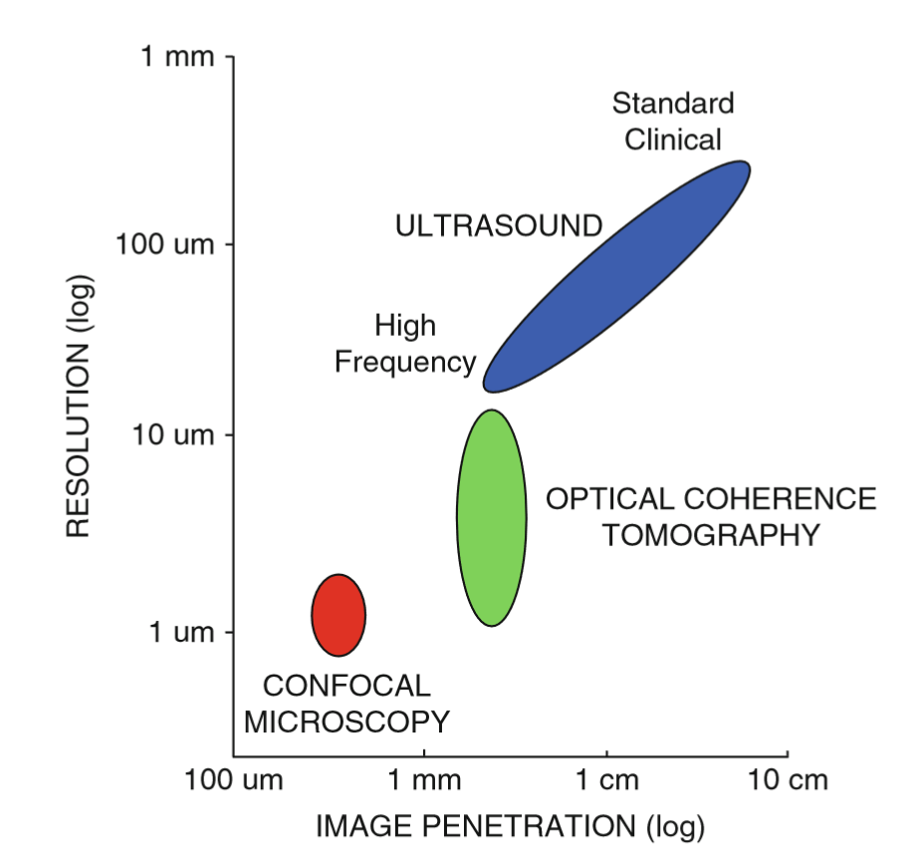
Optical coherence tomography (OCT)
OCT is low-coherence interferometry with
Label-free
High- penetration
High-resolution
Notes:
Optical coherence tomography, OCT is a low coherence interferometry
Compared with some other imaging modalities,
OCT has the advantage of label-free, high-penetration, and high resolution.

Slide 3
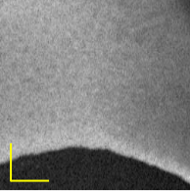
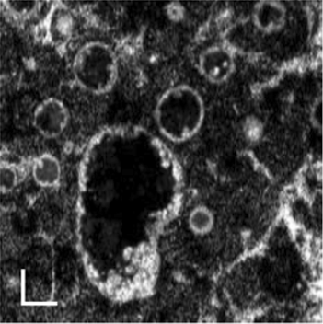
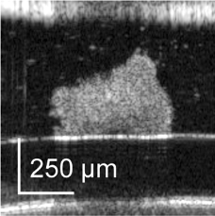
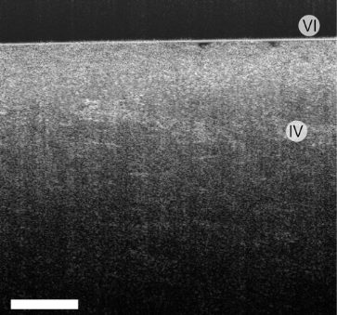
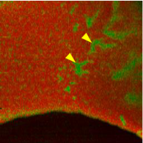
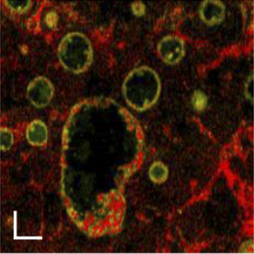
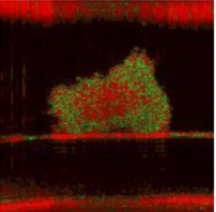
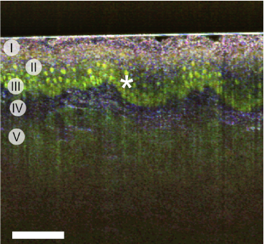
OCT and dynamic OCT (DOCT)
Mouse liver
Organoids
Tumor spheroids
Mouse tongue
Morphological structure
Standard OCT
Intracellular motility, (i.e., tissue dynamics)
DOCT
Biomedical Optics Express 13, 4071–4086 (2022)
Biomedical Optics Express 14, 2333–2351 (2023)
Biomedical Optics Express 11, 6231–6248 (2020)
Optics Letters 45, 4766–4769 (2020)
Notes:
Standard OCT visualizes the three-dimensional morphological structure of the sample.
Based on the standard OCT, recently, dynamic OCT. DOCT has been proposed for the assessment of intracellular motility of tissues. Namely, the tissue dynamics.

Slide 4
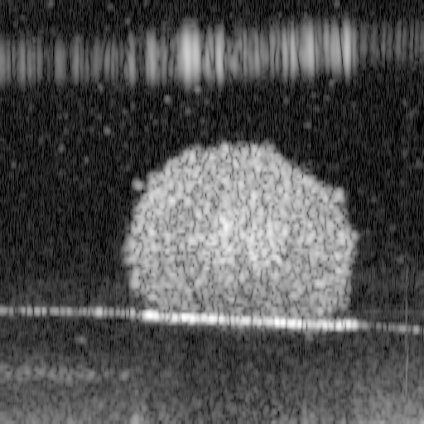
OCT and DOCT
Repeated scanning at the same tissue location
Tens to thousands of frames at same location
Signal processing to extract temporal fluctuation
Standard OCT
DOCT images
signal fluctuation-magnitude analysis
Fluctuation speed analysis
Time-frequency analyses
……
……
t
Notes:
For obtaining the DOCT images, typically, we need to use the standard OCT device to scan the same tissue locations for several times.
Based on the Tens to Hundreds frames,
by using some signal processing methods,
we can analyze the signal fluctuation, hence assess the tissue dynamics.
Till now, several algorithms have been proposed.
Including …

Slide 5
Complication of DOCT
The long acquisition time, harms high throughput imaging, which is important for some applications such as drug screening.
We require high-speed volumetric DOCT imaging.
Can we reduce the number of frames for
DOCT generation?
Notes:
Although the DOCT is successful, it has some limitations.
Because we need to scan many frames at each single location, the acquisition time of DOCT is very long.
That harms the further application of DOCT. For example, the drug screening and the unstable sample imaging.
So, we require the …
The question is whether we can reduce the number of frames for DOCT generation?

Slide 6
What we did
Based on a small number of frames, we use neural network to compute two types of DOCT images.
1. Logarithmic intensity variance (LIV) which senses to the magnitude of fluctuation
2. Amplitude spectral DOCT (AS-DOCT) which senses to the frequency of fluctuation
Notes:
In this study, we aim to accelate the DOCT imageing to realize high-speed DOCT.
We used ///

Slide 7
DOCT: Logarithmic intensity variance (LIV)
Notes:
First, let me start from the LIV

Slide 8
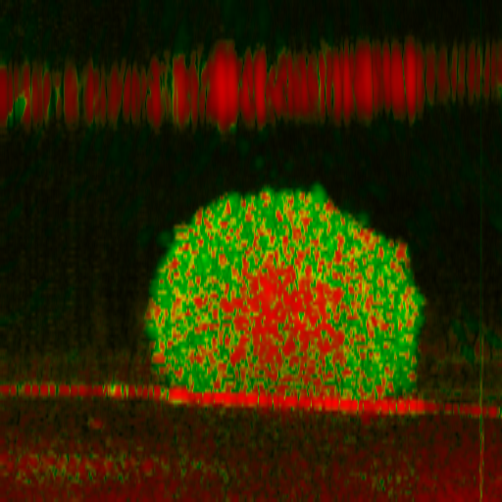
LIV
LIV senses to the magnitude of OCT intensity fluctuation and has been used for tissue metabolism activity investigation.
n: n-th OCT frame
N: Total number of frames for LIV computation
$$\begin{aligned}& Conventional LIV\left(x,z;N\right)={〈{\left(I_{dB}\left(x, z;n\right)−{〈I_{dB}\left(x, z\right)〉}_{N}\right)}^{2}〉}_{N}\end{aligned}$$
x, z: Coordinate along the fast scan and depth direction
I_{dB}: dB-scaled OCT intensity
LIV is the variance of logarithmic-scale OCT signal among N (typically 32) frames.
The volumetric acquisition time of LIV is 52.4 s.
I. Abd El-Sadek, Biomed. Opt. Express 11(11), 6231 (2020).

Slide 9
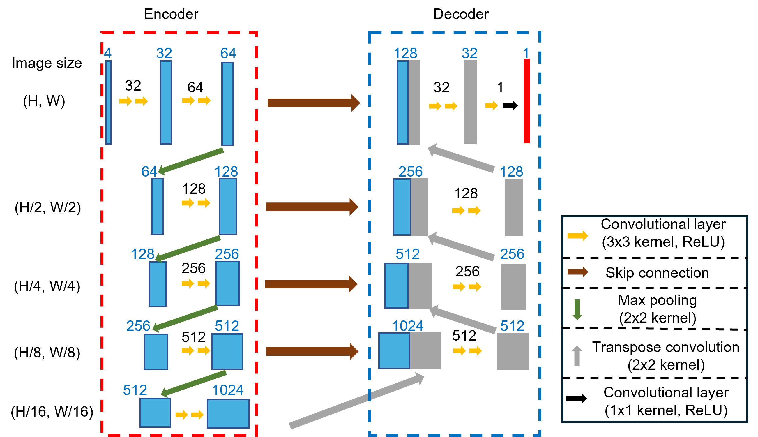
NN architecture for LIV generation

Slide 10
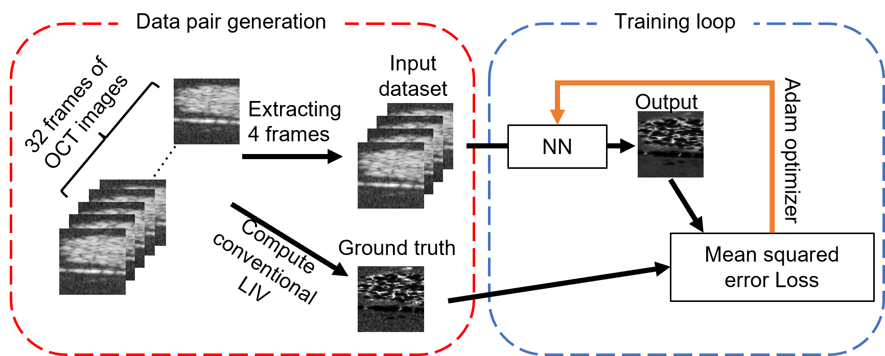
NN training process
Training Samples: 36 breast cancer (MCF-7) spheroids and 36 colon cancer (HT-29) spheroids.
Validation samples: 12 breast cancer (MCF-7) spheroids and 12 colon cancer (HT-29) spheroids.

Slide 11
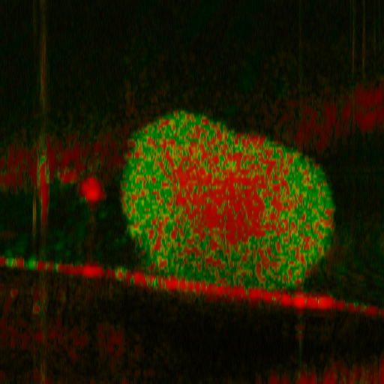
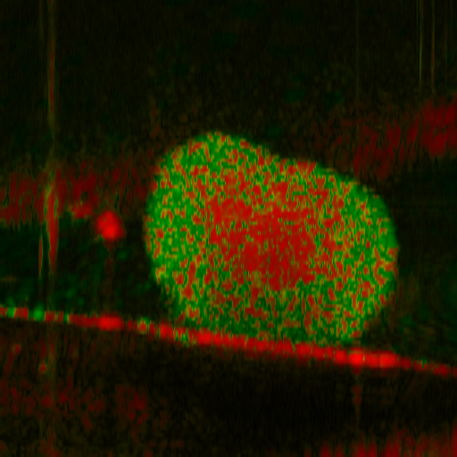

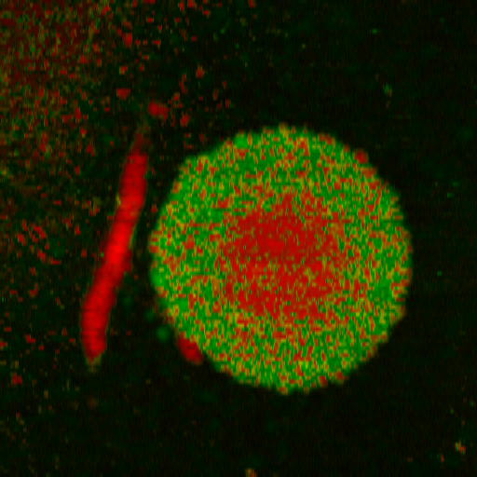

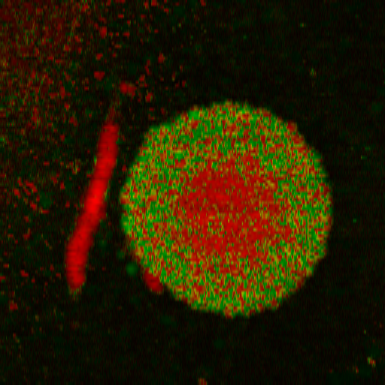

LIV images of breast cancer spheroid
En face cross section
32-frame conventional LIV
(Ground truth)
4-frame NN-based LIV
(Proposed)
4-frame conventional LIV
(Reference)
200 µm
10
LIV
[dB²]
0

Slide 12
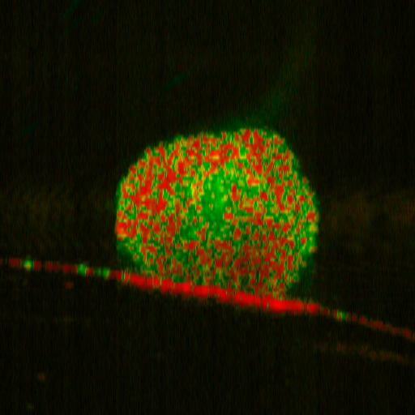
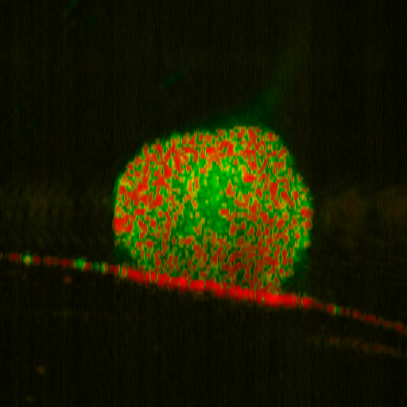
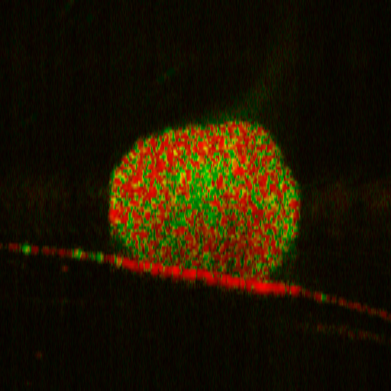
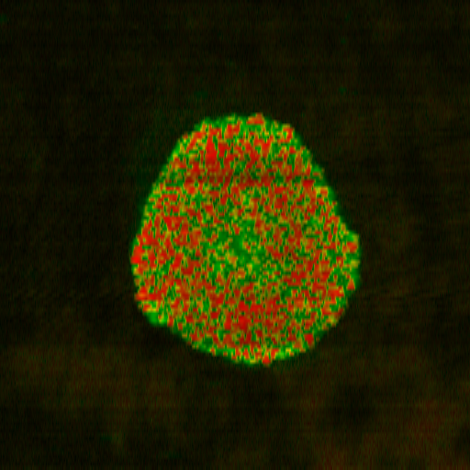
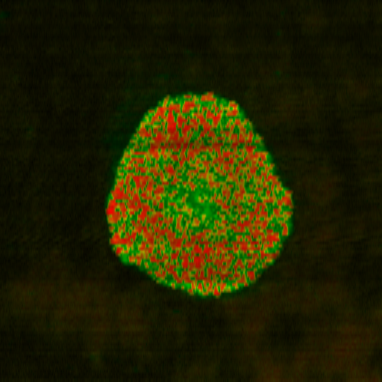
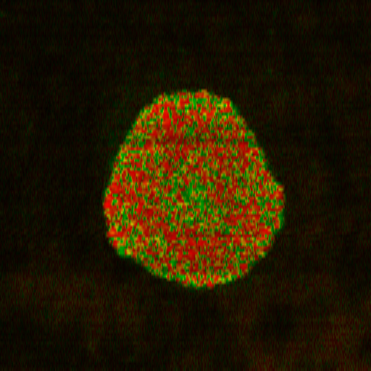
LIV images of colon cancer spheroid
En face cross section
32-frame conventional LIV
(Ground truth)
4-frame NN-based LIV
(Proposed)
4-frame conventional LIV
(Reference)
200 µm
10
LIV
[dB²]
0

Slide 13

Quantitative analysis methods
1. Mean LIV among the whole tumor spheroid volume
24 cancer spheroids
2. Viable cell ratio (VCR) of the whole tumor spheroid volume
$$VCR = \frac{numbers of pixels larger than 3dB²}{Total pixel numbers}$$
I. Abd El-Sadek, Biomed. Opt. Express 11(11), 6231 (2020).
I. A. El-Sadek, Biomed. Opt. Express 12(11), 6844 (2021).

Slide 14
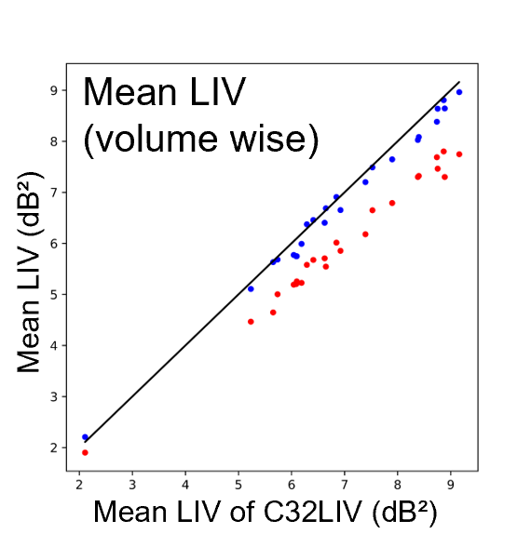
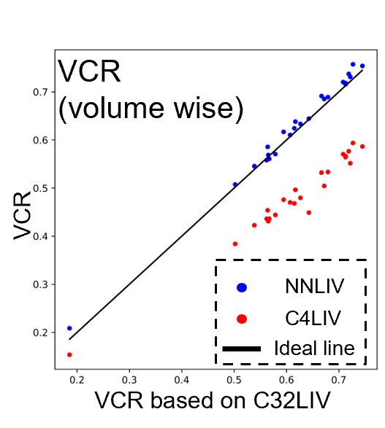
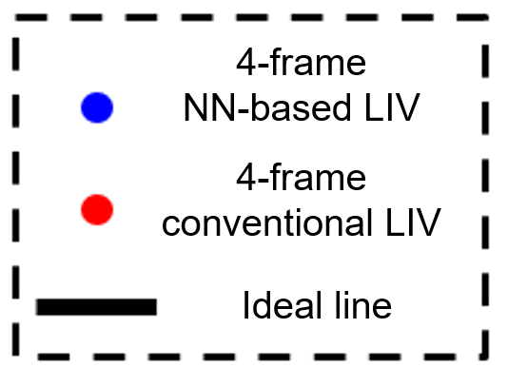
Evaluation metrics based on three types of LIV images
Intraclass correlation coefficients (ICC)
Viable cell ratio
(VCR))
Mean LIV [dB²]
VCR
4-frame
NN-based LIV
4-frame
conventional LIV
Ideal line
Mean LIV of ground truth [dB²]
VCR of ground truth

Slide 15
Agreement based statistical analysis
Intraclass correlation coefficients (ICC)
ICC
1
Excellent
4-frame NN-based LIV
vs
32-frame conventional LIV
0.9
0.9
Good
4-frame conventional LIV
vs
32-frame conventional LIV
0.75
Moderate
0.5
Poor
0
Yellow middle line: ICC
Error bar: 95% confidence interval of ICC
-0.1
Mean LIV of tumor spheroid
Viable cell ratio of tumor spheroid

Slide 16
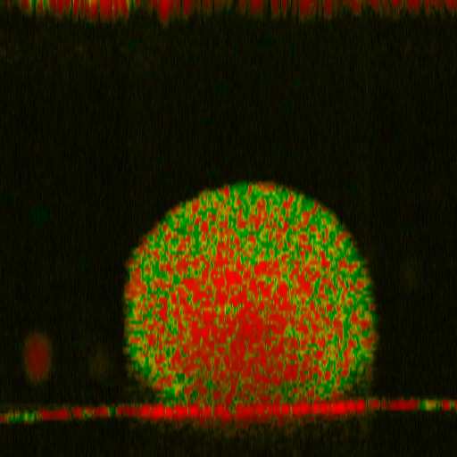
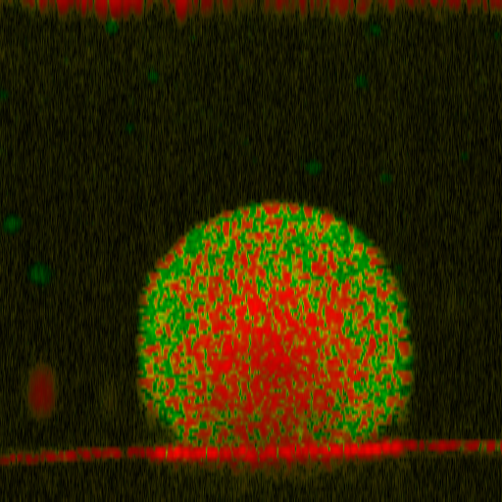
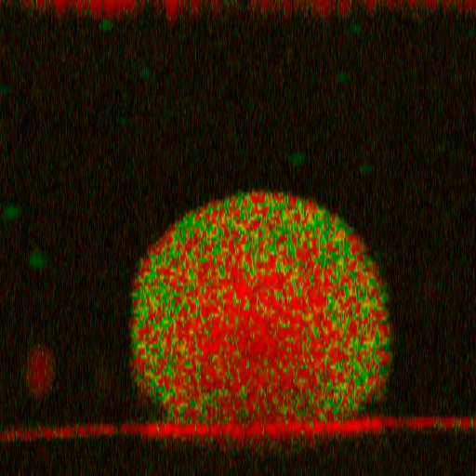
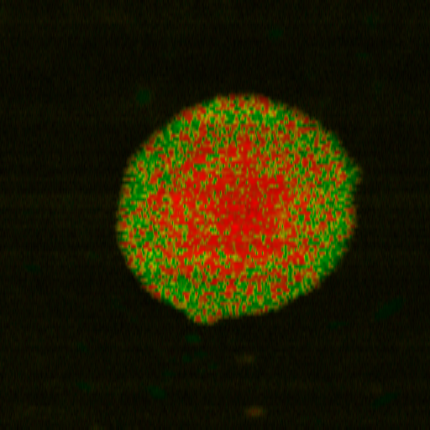
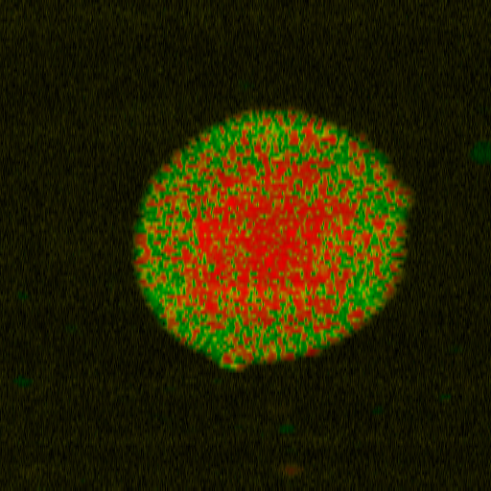
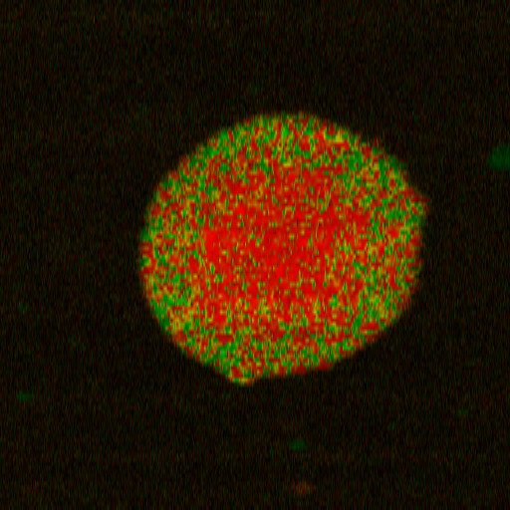
NN-based LIV from practical measurement
En face cross section
32-frame conventional LIV
(Ground truth)
4-frame NN-based LIV
(Proposed)
4-frame conventional LIV
(Reference)
52.4 s
6.55 s
6.55 s
200 µm
Breast cancer spheroid
10
LIV
[dB²]
0

Slide 17
DOCT: Amplitude spectral DOCT (AS-DOCT)

Slide 18
AS-DOCT
Fourier transform along the temporal axis
Integration of each channel
512 frames of OCT images
Amplitude spectrum
Three-channel images
[0 – 0.6 Hz]
[0.6 – 5 Hz]
[5 – 25 Hz]
Low frequency
Moderate frequency
High frequency
Amplitude spectral DOCT image
AS-DOCT senses to the frequency of the intracellular motility.
The requirement of hundreds of frames per location makes it
unrealistic for the volumetric acquisition (around 1 hour per volume).

Slide 19
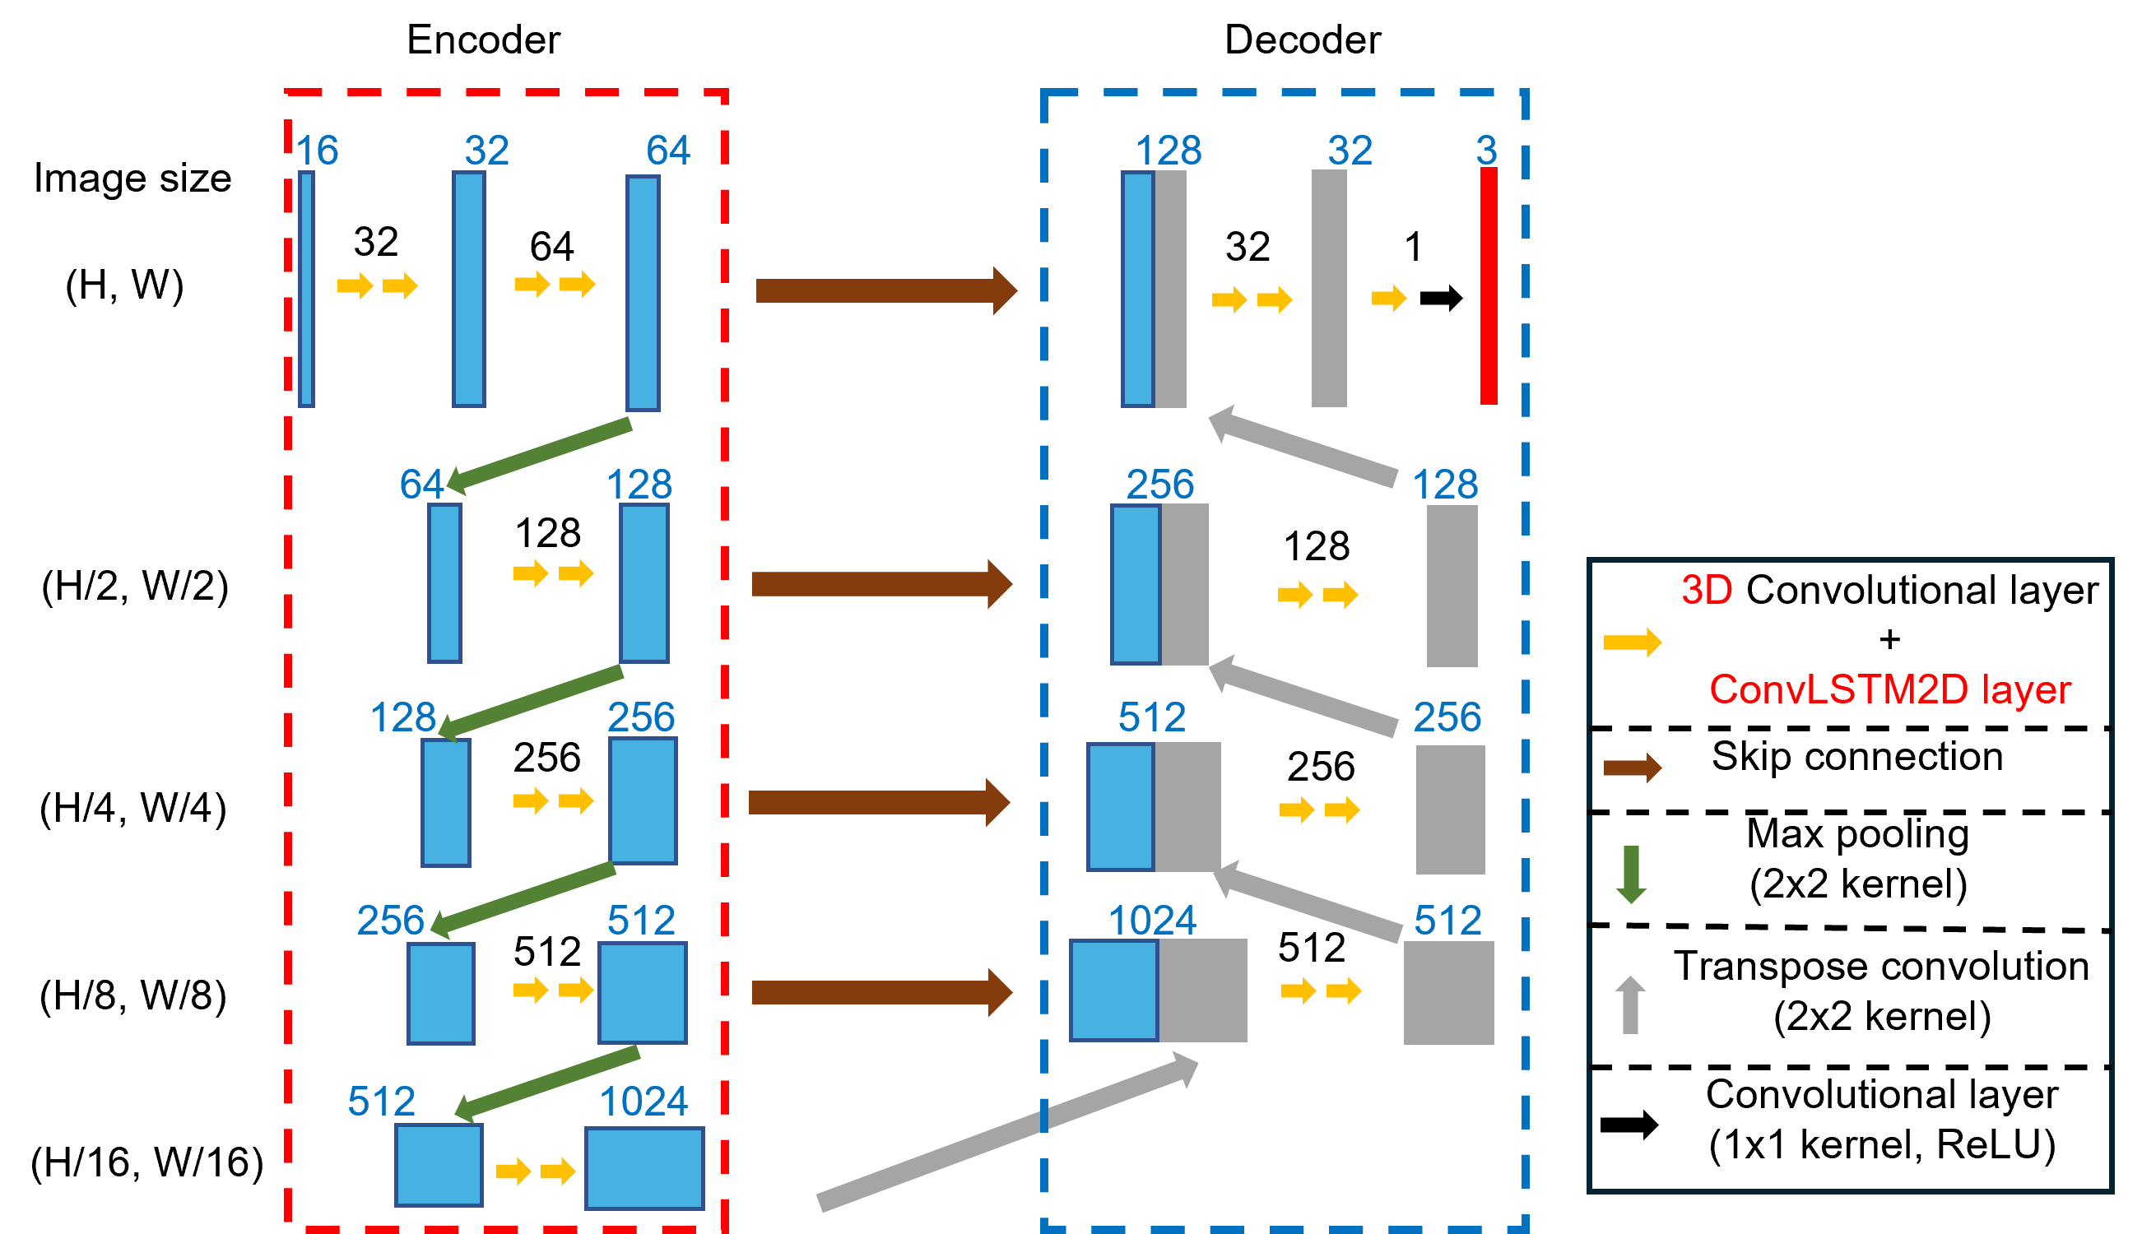
NN architecture for AS-DOCT generation
Extract the temporal feature

Slide 20
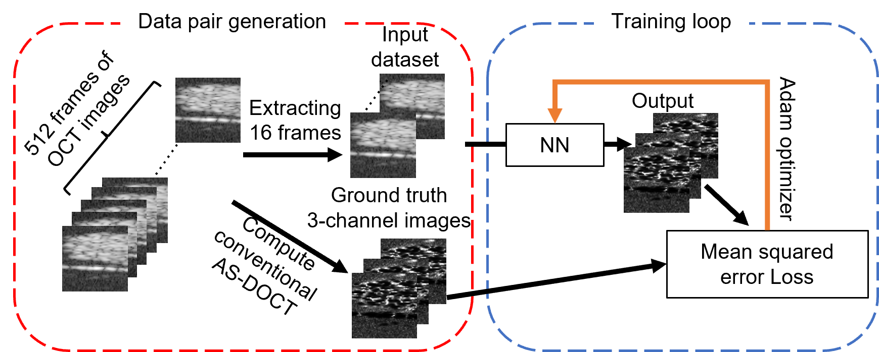
NN training process
Training Samples: 174 cancer spheroids
Validation samples: 19 cancer spheroids

Slide 21
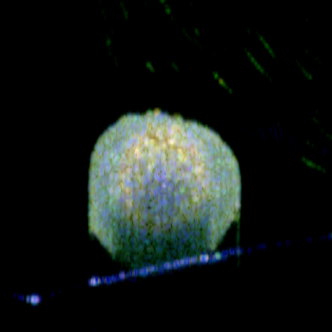
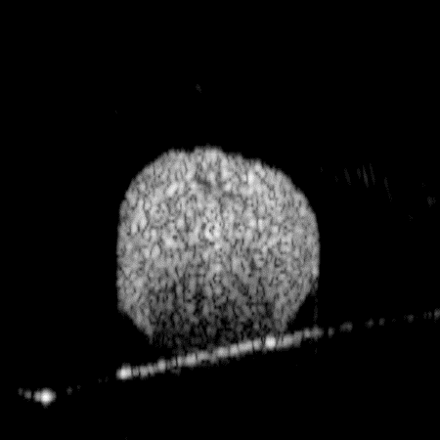
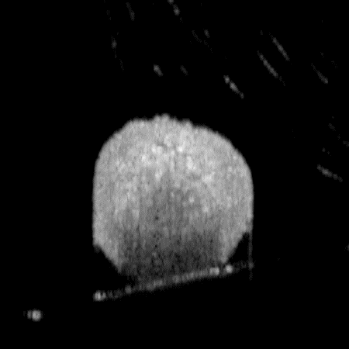
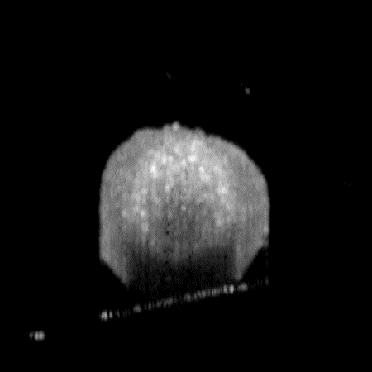
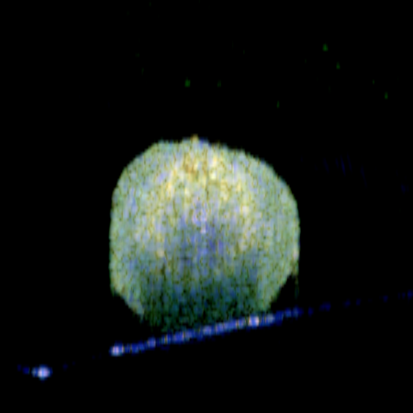
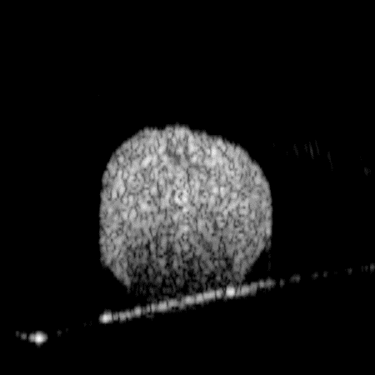
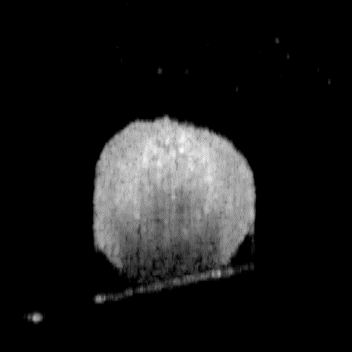
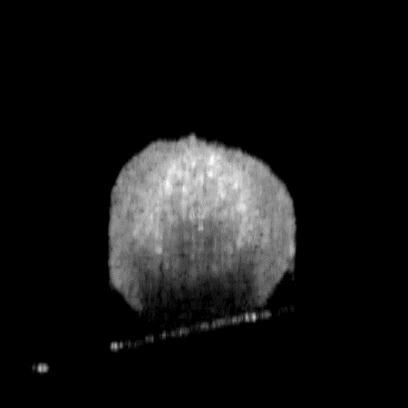
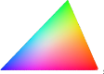
In vitro breast cancer spheroid
NN-generated Ground truth
RGB
Low fre. (blue)
Moderate fre. (green)
High fre. (red)
200 µm
0.6 - 5 Hz
0 - 0.6 Hz
5 - 25 Hz

Slide 22
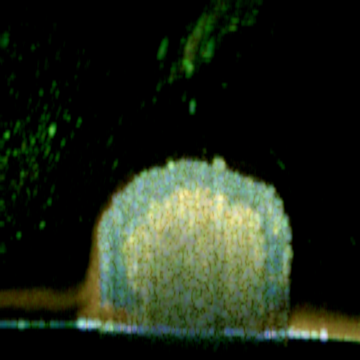
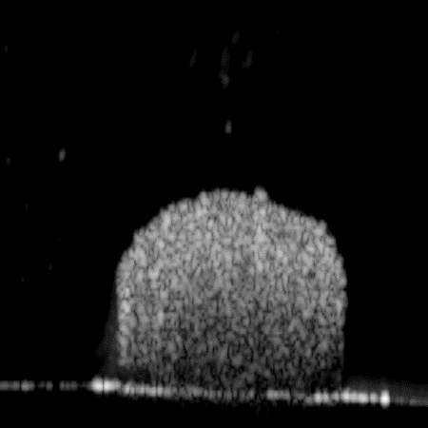
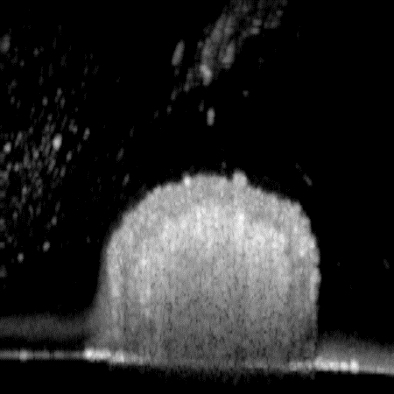
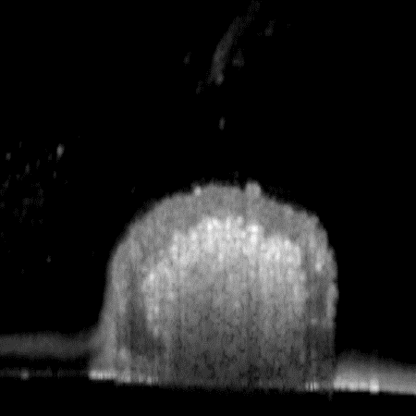
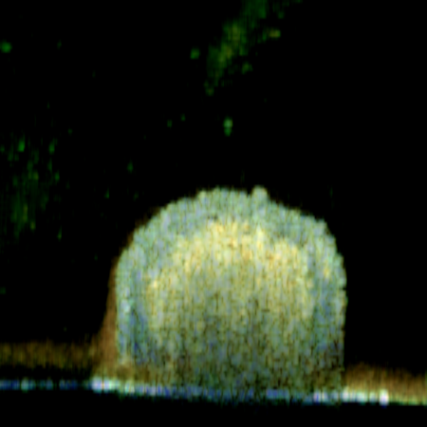

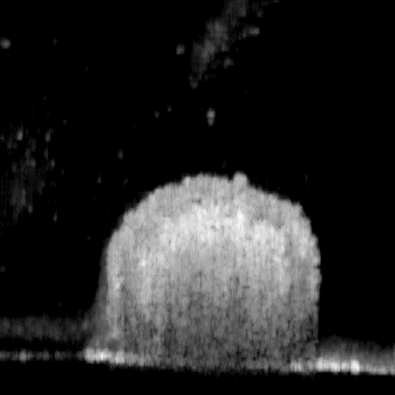

In vitro colon cancer spheroid
NN-generated Ground truth
RGB
Low fre. (blue)
Moderate fre. (green)
High fre. (red)
200 µm
0.6 - 5 Hz
0 - 0.6 Hz
5 - 25 Hz

Slide 23
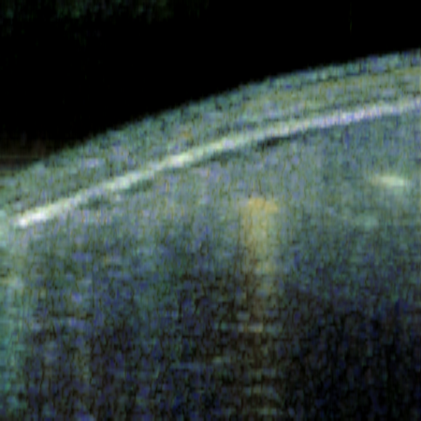





NN-AS-DOCT (practical measurement) : In vivo zebrafish
Zebrafish 1
Zebrafish 2
Zebrafish 3
En face Cross-section
26 s
200 µm
0.6 - 5 Hz
0 - 0.6 Hz
5 - 25 Hz

Slide 24

Conclusion

Slide 25
Conclusion
We demonstrated using neural networks to generate two type of DOCT images from fewer OCT frames.
The NN-based DOCT and conventional DOCT images show high resemblance.
The NN-based algorithm shows the potential for realizing the high-speed DOCT imaging.

